Slide 1
JEFFERSONVILLE SOCCER CLUB
COVID 19 – *Return to Play Plan
December 2020
*JSC reserves our rights to amend this plan at anytime as new information becomes available.

Slide 2
JEFFERSONVILLE SOCCER CLUB
COVID 19 Plan – Table of Contents
Rules and Protocols
COVID 19 Incident Action Plan
General Hygiene and Safety Guidelines
Parent/Guardian Guidelines
Coaches Guidelines
Padden Park Map (Practices)
Game Guidelines
Padden Park Map (Games)
Game/Training Guidelines and Protocols (INDOOR)
Appendix A – JSC Disinfectant Guidelines
Appendix B - Additional Resources

Slide 3
JEFFERSONVILLE SOCCER CLUB
COVID 19 Plan – Return to Play Practice Plan
Rules and Protocols
Jeffersonville Soccer Club is committed to providing a fun and safe environment for all of its players, volunteers, parents and spectators. While the spread of COVID 19 and other types of viruses are difficult to control, JSC is implementing rules and protocols designed to mitigate these types of risks. Actions regarding COVID 19 are fluid and frequently changing. JSC will amend our plan as necessary.
Rules
All Parents, Players, and spectators are required to follow any rules or directions given by a coach or JSC Board Member. If any rule or direction is not followed, JSC (solely at its discretion), may excuse the individual from the facility or cancel the activity.
Parents/spectators are able to attend soccer practices (this is not recommended, but allowed if a parent feels it is necessary). JSC requires that only 1 parent/spectator per player attends games. Social distancing of 6 feet must be maintained and face coverings must be worn at all times by both spectators and coaches. Players are required to wear face coverings while walking to and from the field. Players may be required to wear face coverings during all soccer activities. Coaches will advise when this is required.
No Player, Parent, Guardian or spectator should attend a soccer activity if they are not feeling well. Parents are required to screen their players before each soccer activity and if they are displaying symptoms of COVID 19, player should not attend soccer activities. Symptoms may include, but not limited to fever or chills, cough, shortness of breath or difficulty breathing, fatigue, muscle/body aches, headache, loss of taste or smell, sore throat, congestion or runny nose, nausea or vomiting, or diarrhea. If a coach or board member observes a person with these symptoms, the person will be asked to leave the facility immediately.

Slide 4
JEFFERSONVILLE SOCCER CLUB
COVID 19 Plan – Return to Play Practice Plan
Rules and Protocols
Protocols
Practice start and end times will be staggered, to the extent possible, by team to limit the number of people entering and exiting the facility.
Players and families should not congregate together in groups before, during or after a soccer activity. Families should enter and depart the facility quickly.
All players must sanitize hands before activities, the Club will provide each team with sanitizer.
Social distancing will be employed by coaches during practices and breaks.
Coaches must wear face coverings covering their mouth and nose during practices.
Players must wear face coverings during breaks in play. Face coverings may be required during all soccer activities.
Players are not allowed to share water.
Coaches must sanitize all equipment before/after each practice. Each team will be supplied with disinfectant and gloves by the club. JSC disinfectant guidelines must be followed. Please see Appendix A.
Coaches will wash all scrimmage vests after each practice.
Handshakes or other celebrations where contact is involved will not be permitted. Coaches and player can get creative in alternative approaches.
Limited number of players and coaches allowed on a field at one time.
Coaches are required to maintain an attendance log for each soccer activity.

Slide 5
JEFFERSONVILLE SOCCER CLUB
COVID 19 Plan – Action Plan for COVID 19 Incident
COVID 19 – Coordinator
President, Jeff Winters
Email – jwinters@jvillesc.com
Phone – 215-435-7817
If a player tests positive for COVID 19 or has been around a person who had COVID 19, the following protocols must be followed:
If a player exhibits symptoms during soccer activities, the player will be sent home.
Player’s parent is to report the incident to the club President, Jeff Winters by either sending an email to jwinters@jvillesc.com or calling at 215-435-7817.
Incident will be maintained in a log.
Incident will be reported to the Montgomery County Department of Health and Human Services (Michel Masters – mmasters@montcopa.com) .
Player will be permitted to return to soccer activities when the CDC guidelines for When You Can Be Around Others have been met AND a physician provides a note indicating that the player is able to return to soccer activities.
*All COVID 19 incidents must be reported to the coordinator immediately.*

Slide 6
JEFFERSONVILLE SOCCER CLUB
COVID 19 Plan – General Hygiene and Safety Guidelines
Wash your hands frequently
Have hand sanitizer available for all at times.
No sharing of water, snacks or equipment
No shaking hands, high fives, fist bump, hugs, etc.
Social distancing = 6 feet apart
No player or coach can attend practice or game if they are feeling sick.
Sick players or coaches must quarantine as required by CDC/PA Dept. of Health. Can only return with a Doctor’s approval. Must show notice to the club.
Disinfect all training equipment-cones, goals, flags etc.
Coaches to wear a face covering as per CDC/PA Dept. of Health guidelines
Players to wear face covering when not involved in soccer activities or on the bench. Player may wear face covering during activity at parents or players discretion.
Scrimmage vests washed after every session.
Each ball sanitized before/after every practice or game.
Only one coach may attend to an injured player. Must wear face covering and gloves.
Minimize contact with other teams before, during and after each session

Slide 7
JEFFERSONVILLE SOCCER CLUB
COVID 19 Plan – Parent/Guardian Guidelines
Comply with Commonwealth of Pennsylvania, Eastern Pennsylvania Youth Soccer and any additional club directives or requirements. Share information with your son or daughter.
No signs of COVID-19 for the player the past 14 days and no known exposure before sending him or her to training. Sick players and coaches must stay at home and follow appropriate health guidelines.
Access facilities using the Padden Park Access Map.
Determine if you want your child to wear a face covering during training.
Sanitize and wash all equipment and uniforms after training or games.
Pack hand sanitizer and a face covering in his or her bag.
Spectators are not essential to training and not recommended to attend, however, it may be necessary for younger players. Please consult with your coach. Spectators must wear face coverings while attending soccer activities.
Comply with social distancing and face covering directives. Adhere to rules of the club regarding attending training session.
Direct your child to never share water, snacks or equipment.
Notify club Covid Coordinator and coach should your child become ill.
Do not assist coach or coaches with equipment at the beginning or end of practice unless requested to by a coach.
Ball goes off touchline or end line allow players or coach to retrieve the ball.
Parents make the ultimate decision on their child's attendance/participation.
Parents MUST mark player attendance on Team Snap app.
Parents MUST complete the registration process for the 2020/2021 season BEFORE your child begins to participate.

Slide 8
JEFFERSONVILLE SOCCER CLUB
COVID 19 Plan – Coaches Guidelines
Comply with Commonwealth of Pennsylvania, Eastern Pennsylvania Youth Soccer and any additional club directives or requirements.
Reinforce directives, polices and protocols as necessary with parents and children.
As players arrive, inquire how they’re feeling. If they are ill or appear to be ill, send them home
Coaches are required to maintain an attendance log for each soccer activity.
Supply your medical kit or bag with gloves, extra face coverings, sanitizer, and facial tissues.
Implement social distancing where possible. Each player and their equipment must be at least six feet from the next player.
Coaches must wear face coverings at all times.
Players may wear face coverings during training at their discretion. Must wear when not engaged in soccer activity.
Sanitize all equipment after training. Follow JSC disinfecting guidelines.
Scrimmage vests should be washed after each training.
Minimize interaction with other teams that train before or after you. Emphasize player should go straight to cars.
All soccer activities MUST be entered in Team Snap app and parents MUST mark attendance in this app.
Be positive, fun and engaging. Help the children acclimate and reintegrate.

Slide 9
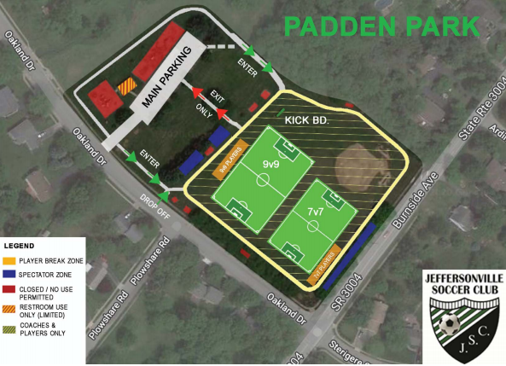
JEFFERSONVILLE SOCCER CLUB
COVID 19 Plan – Padden Park Map (Practice)
Players dropped off at Oakland Drive Entrance
Parents of younger players who wish to stay at Padden, must park in the parking lot at Padden Park.
Green Arrows show the players path to the field
Players must exit the field by using the Padden Park Parking Lot
Practice start and end times will be staggered to foster social distancing
Parents and players should not congregate before or after practice
Players should arrive at field 10 minutes before the start of their practice
Parents should be in parking lot to pick up 10 minutes before the end of their practice

Slide 10
JEFFERSONVILLE SOCCER CLUB
COVID 19 Plan – Game Guidelines and Safety Protocols
In order to create a safe environment for our teams, spectators, and staff, the following guidelines and safety protocols must be adhered to at the JSC complex:
If you recently traveled to a state or other location on the PA Travel Restriction listing, JSC expects that you will self-quarantine in accordance with PA guidelines.
No coach, player, parent, spectator, or referee should attend a soccer activity if they are not feeling well. Individuals planning to attend a JSC activity are required to screen themselves for symptoms of COVID-19 before each JSC activity. We note that it is the parent’s responsibility to screen players. If anyone is displaying symptoms of COVID-19, they are prohibited from participating in any JSC activities. Symptoms of COVID-19 include fever or chills, cough, shortness of breath or difficulty breathing, fatigue, muscle/body aches, headache, loss of taste or smell, sore throat, congestion or runny nose, nausea or vomiting, or diarrhea. Anyone exhibiting these symptoms will be asked to leave the facility immediately.
Parents and/or spectators should bring personal hand sanitizer to games. The sharing of food/water is prohibited. No spitting.
Parents and spectators must comply with social distancing guidelines and remain at least 6 feet apart at all times. Face coverings are required for all spectators and coaches. Face coverings are required for players, parents, coaches, referees and spectators when they are walking from their car to the field. Players and referees will not be required to wear face coverings while playing or warming up for a game.
Individuals with pre-existing conditions etc. that may be more vulnerable to COVID-19 are not encouraged to attend JSC activities.
Only one parent/spectator per player is permitted at the JSC complex. Players and spectators from the same team must stand on the same sideline. JSC’s sideline will be between the 9 v 9 and 7 v 7 field.

Slide 11
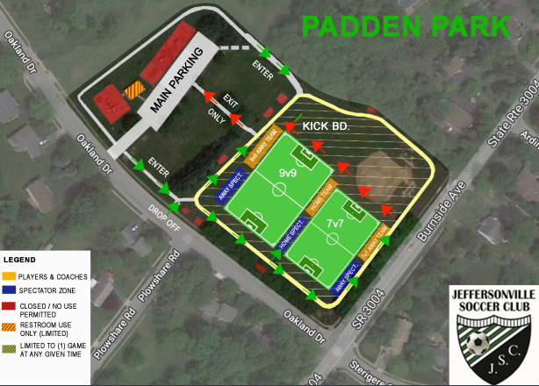
JEFFERSONVILLE SOCCER CLUB
COVID 19 Plan – Padden Park Map (Games)

Slide 12
JEFFERSONVILLE SOCCER CLUB
COVID 19 Plan – Game/Training Guidelines and Protocols (INDOOR)
In order to create a safe environment for our teams, spectators, and staff, the following guidelines and safety protocols must be adhered to:
If you recently traveled to a state or other location on the PA Travel Restriction listing, JSC expects that you will self-quarantine in accordance with PA guidelines.
No coach, player, parent, spectator, or referee should attend a soccer activity if they are not feeling well. Individuals planning to attend a JSC activity are required to screen themselves for symptoms of COVID-19 before each JSC activity. We note that it is the parent’s responsibility to screen players. If anyone is displaying symptoms of COVID-19, they are prohibited from participating in any JSC activities. Symptoms of COVID-19 include fever or chills, cough, shortness of breath or difficulty breathing, fatigue, muscle/body aches, headache, loss of taste or smell, sore throat, congestion or runny nose, nausea or vomiting, or diarrhea. Anyone exhibiting these symptoms will be asked to leave the facility immediately.
Individuals with pre-existing conditions etc. that may be more vulnerable to COVID-19 are not encouraged to attend JSC activities.
Players should bring personal hand sanitizer to games and trainings. The sharing of food/water is prohibited. No spitting.
Face coverings are required for players, parents, coaches, trainers, referees and spectators at all times during games and trainings.
Indoor Trainings – Players, coaches, and trainers are the ONLY people allowed inside any training facility being utilized by JSC teams. Parents are NOT allowed inside any training facility at any time.
Indoor Facilities – JSC families are required to follow all guidelines of the facility where the games and trainings are being held. JSC families are encouraged to visit the website of each facility prior to arriving at the facility. Below is a list of frequently used facilities by JSC and their COVID guidelines.
Penn Christian Academy – https://www.pennchristian.org/covid-reopening-plan/
YSC (Wayne) - https://yscsports.com/sites/default/files/Winter%20%2720%20YSC%20Youth%20Soccer%20Travel%20League%20COVID19%20Protocols%5B1%5D22.pdf

Slide 13
JEFFERSONVILLE SOCCER CLUB
COVID 19 Plan – Appendix A – Disinfectant Guidelines
Chemicals utilized are hospital grade disinfectants effective against viral pathogens listed on EPA List N effective against COVID - 19
Disinfection Procedures for Soccer Balls and Cones
Perform after each use of facility or equipment - USE SPARTAN HDQ NEUTRAL DISINFECTANT
Use Quart bottle of Spartan HDQ Disinfectant Cleaner
To refill quart bottle, ¼ ounce of disinfectant per quart of water.
Wipe away excess dirt from balls or cones before applying solution.
Spray solution liberally onto surfaces of balls and cones and allow to air dry for 10 minutes. Do not oversaturate as spraying more chemical does not help disinfect any better.
After 10 minutes, wipe off any excess solution.
Disinfection Procedures for Goal Posts
Perform after each use of facility - USE SPARTAN HDQ NEUTRAL DISINFECTANT
Use Quart bottle of HDQ Disinfectant Cleaner
To refill quart bottle, ¼ ounce of disinfectant per quart of water.
Wipe away excess dirt from posts before applying solution.
Spray solution liberally onto surfaces of posts and allow to air dry for 10 minutes. Do not oversaturate as spraying more chemical does not help disinfect any better.
After 10 minutes, wipe off any excess solution.

Slide 14
JEFFERSONVILLE SOCCER CLUB
COVID 19 Plan – Appendix A – Disinfectant Guidelines
Disinfection Product Information – Product Name – GS Neutral Disinfectant Cleaner
Safety Data Sheet – Coaches must have a copy of this sheet availably at all JSC soccer activities.
GS Neutral Disinfectant Cleaner – Bottle Label
GS Neutral Disinfectant Cleaner – Ingredient Communication Statement

Slide 15
JEFFERSONVILLE SOCCER CLUB
COVID 19 Plan – Appendix B - Resources
Commonwealth of Pennsylvania
https://www.governor.pa.gov/plan-for-pennsylvania/
Pennsylvania Department of Health
https://www.health.pa.gov/topics/disease/coronavirus/Pages/Coronavirus.aspx
CDC Considerations for Youth Sports
https://www.cdc.gov/coronavirus/2019-ncov/community/schools-childcare/youth-sports.html
United States Olympic Committee and Paralympic Committee
https://www.teamusa.org/coronavirus
US Soccer
https://www.ussoccer.com/playon/guides/phase-1-grassroots
US Youth Soccer
https://www.usyouthsoccer.org/assets/1/6/usys_rta_notice_051920.pdf
Pennsylvanian Recreation and Park Society
https://prps.org/common/Uploaded%20files/Resources/PRPS%20Park%20and%20Rec%20Facility%20Reopening%20Guidelines%20%2020200512.pdf

